Slide 1
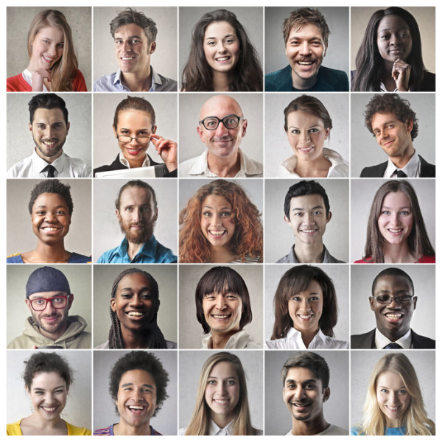
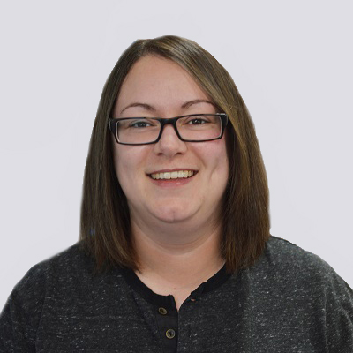
The pairs training effect in unfamiliar face and voice matching
Kay Ritchie, Nadine Lavan & Patricia Bestelmeyer
kritchie@lincoln.ac.uk
@KayRitchiePsych

Slide 2






Face and Voice Identification
kritchie@lincoln.ac.uk
@KayRitchiePsych

Slide 3
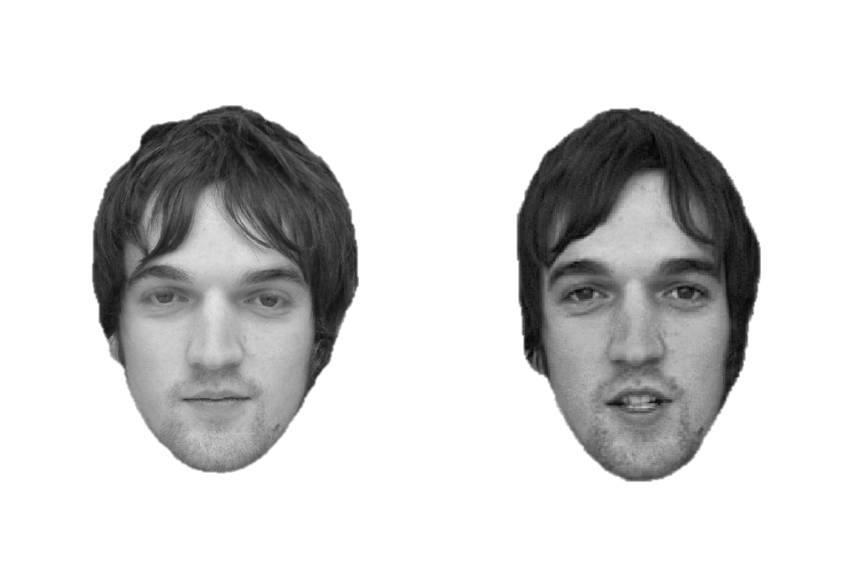
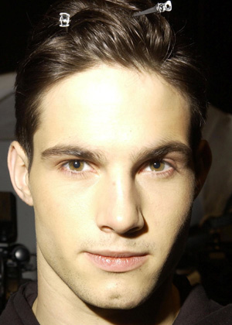
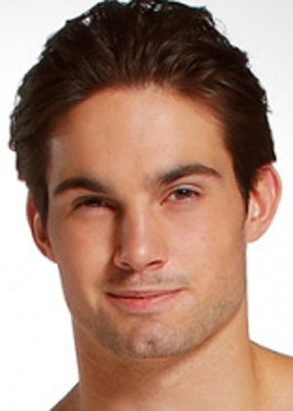
Face Matching
Glasgow Face Matching Test
Models Face Matching Test
Burton et al. (2010) BRM
Dowsett & Burton (2015) BJP
Accuracy: 65% - 80%
kritchie@lincoln.ac.uk
@KayRitchiePsych

Slide 4

Voice Matching
Bangor Voice Matching Test
Mühl et al (2018) BRM
Match
Mismatch
Accuracy: 65% - 80%
kritchie@lincoln.ac.uk
@KayRitchiePsych

Slide 5
Similarities Between Faces and Voices
Familiarity effects (e.g. Kanber, Lavan & McGettigan, 2022, JEP: General)
Learning from variability (e.g. Lavan et al, 2019, Cognition)
Trait formation (e.g. Mileva & Lavan, 2023, JEP: General)
kritchie@lincoln.ac.uk
@KayRitchiePsych

Slide 6



Improving Performance
Improvement over time (faces)
Training (faces)
Changing the stimuli (faces)
Multimodal information (faces and voices)
Working in pairs (faces)
White et al (2014) Plos one
Towler et al (2019) Plos one
White et al (2014) JEP: Applied;
cf Ritchie et al (2021) Cognition
Harriet’s talk!
Dowsett & Burton (2015) BJP
kritchie@lincoln.ac.uk
@KayRitchiePsych

Slide 7
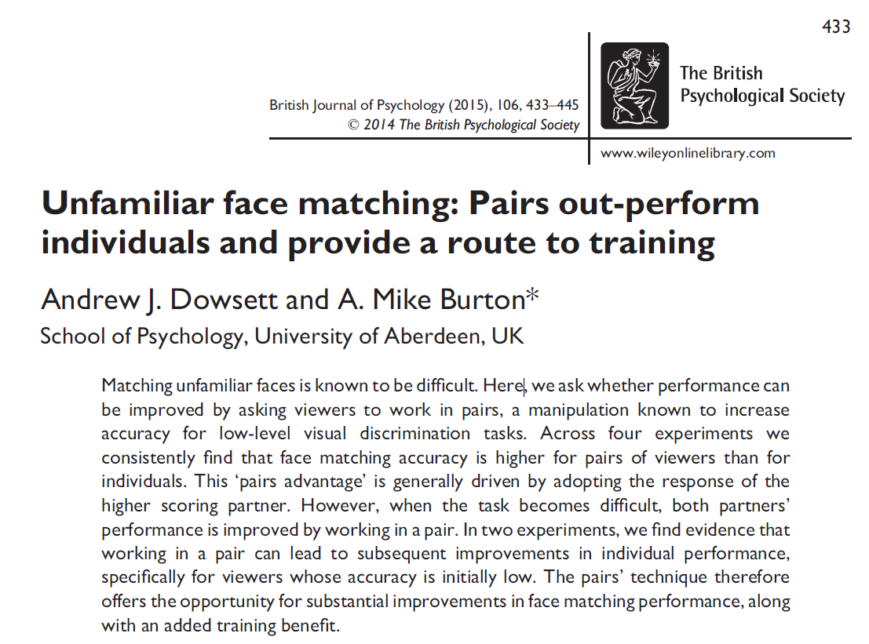
kritchie@lincoln.ac.uk
@KayRitchiePsych

Slide 8


Time 1 - Individual
Time 2 - Pairs
Time 3 - Individual
kritchie@lincoln.ac.uk
@KayRitchiePsych

Slide 9
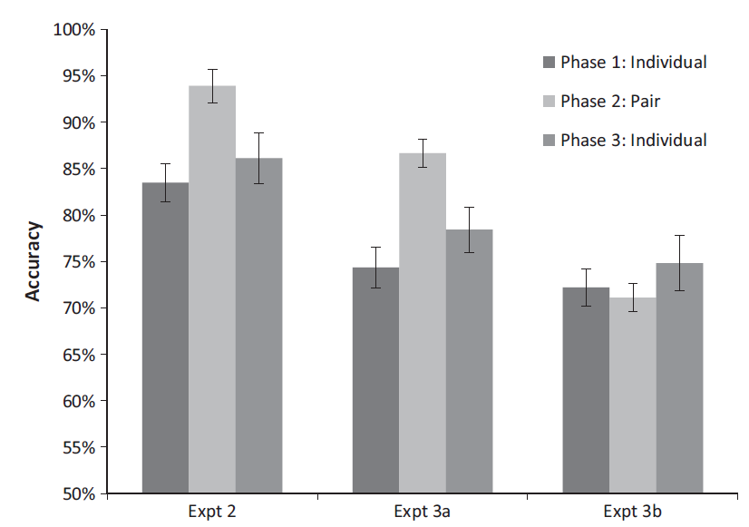
GFMT
MFMT
Control Exp
kritchie@lincoln.ac.uk
@KayRitchiePsych

Slide 10
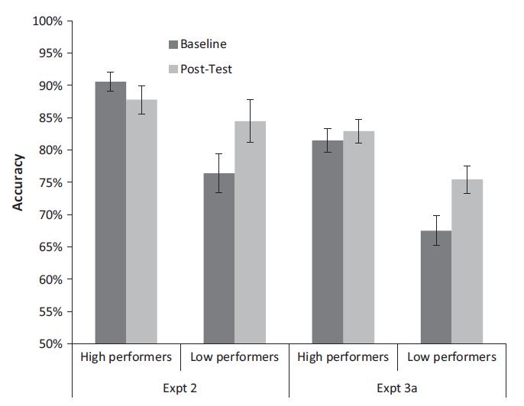
High vs Low Performers
kritchie@lincoln.ac.uk
@KayRitchiePsych

Slide 11
Ritchie et al (2022) Exp 1
Time 1 - Individual
Time 2 - Pairs
Time 4 – Individual
7 days later
Time 3 - Individual
Accuracy +
Confidence
kritchie@lincoln.ac.uk
@KayRitchiePsych

Slide 12
Exp 1
“Week” delay: Mean 20 days, Range 7-54 days
Confidence?
 | High Performers | Low Performers
T1: Individual | 4.90 (0.98) | 5.25 (0.53)
T3: Individual | 5.00 (0.62) | 5.54 (0.63)
T4: Individual Delay | 4.73 (0.61) | 5.13 (0.57)
kritchie@lincoln.ac.uk
@KayRitchiePsych

Slide 13

Exp 2
Time 1 - Individual
Time 2 - Pairs
Time 3 - Individual
No Time 4
No confidence
Add RTs
kritchie@lincoln.ac.uk
@KayRitchiePsych

Slide 14
Exp 2
Accuracy
RTs
kritchie@lincoln.ac.uk
@KayRitchiePsych

Slide 15
Across Both Exps
Absolute value of high performer’s accuracy at T1?
T1 difference between high and low?
kritchie@lincoln.ac.uk
@KayRitchiePsych

Slide 16
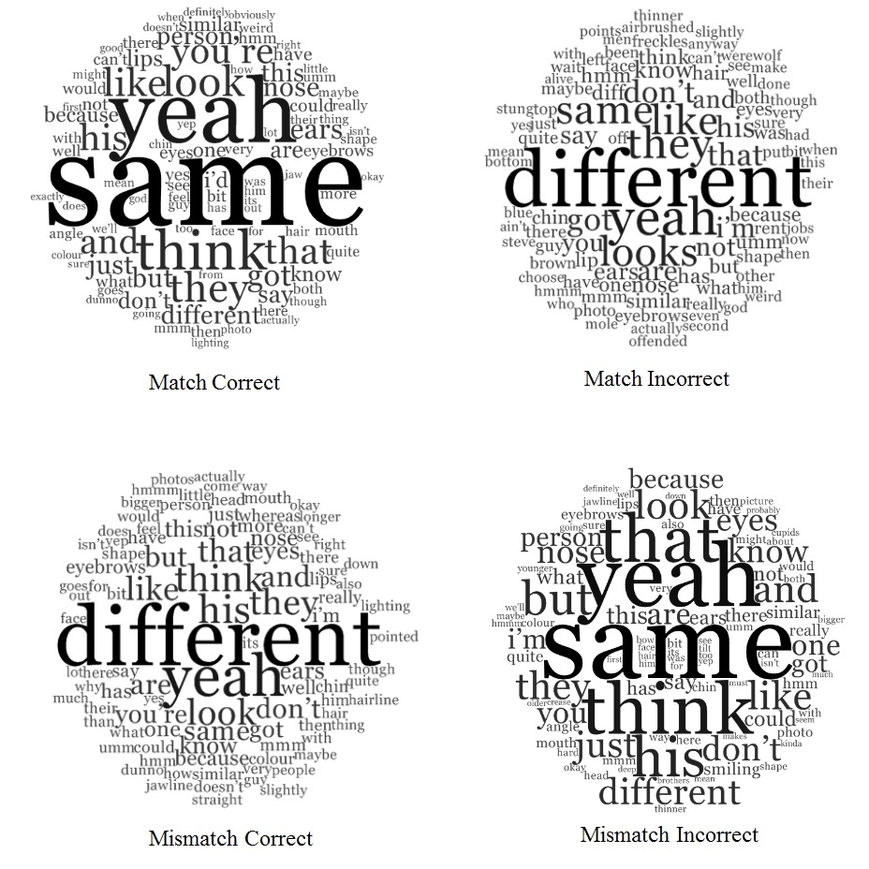
Content of the Discussion
Things that don’t explain the results:
Mentioning facial features
How much they speak
High performer disagreeing with low
Who speaks first
kritchie@lincoln.ac.uk
@KayRitchiePsych

Slide 17
What’s driving the pairs effect?
From Dowsett & Burton (2015)
Not social facilitation (performing better in the presence of another)
Not practice effects
Not confidence
The effect lasts
Not RT
Not what they say
Not T1 difference between high and low
Not absolute value of high performer’s accuracy at T1
Our Exp 1
Our Exp 2
Our Exps 1 & 2
Ritchie, Flack, Fuller, Cartledge & Kramer (2022) Perception
kritchie@lincoln.ac.uk
@KayRitchiePsych

Slide 18
Voice Matching
Bangor Voice Matching Test
Mühl et al (2018) BRM
Split into 3 blocks of equal difficulty based on original data
15 match and mismatch trials per block
Equal number of male and female voices per block
 | Block 1 | Block 2 | Block 3
Match % correct (SD) | 72.17 (10.35) | 71.29 (11.29) | 72.49 (10.67)
Mismatch % correct (SD) | 68.46 (9.71) | 68.07 (9.18) | 69.22 (8.83)
Overall % correct (SD) | 70.31 (10.04) | 69.68 (10.24) | 70.85 (9.76)
kritchie@lincoln.ac.uk
@KayRitchiePsych

Slide 19

Sequential Voice and Face Matching
Voice 1
Gap
Face 1
Voice 2
Gap
Face 2
kritchie@lincoln.ac.uk
@KayRitchiePsych

Slide 20
Voice Matching in Pairs (N = 48 pairs)
High: T1 > T2 (small BF) Low: pairs training
kritchie@lincoln.ac.uk
@KayRitchiePsych

Slide 21
Sequential Face Matching in Pairs (N = 51 pairs)
High: T2 > T3 (small BF) Low: pairs training
kritchie@lincoln.ac.uk
@KayRitchiePsych

Slide 22
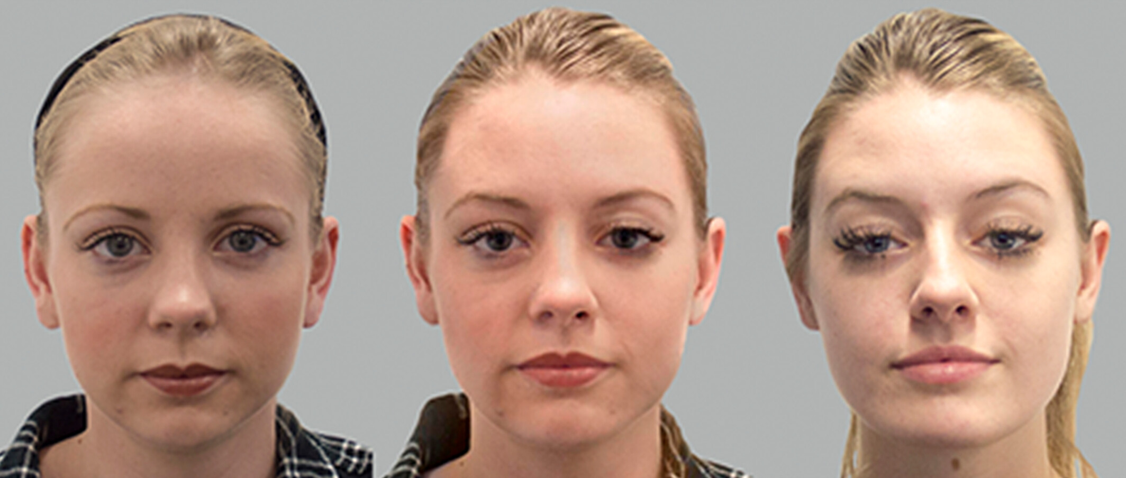
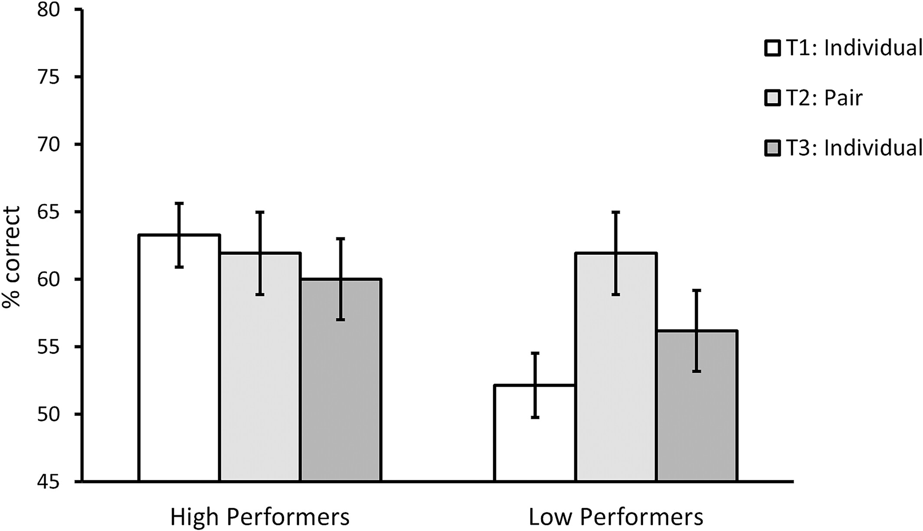
Pairs aren’t just for matching
Face morphs – Flack et al (2023) Applied Cog Psy
kritchie@lincoln.ac.uk
@KayRitchiePsych

Slide 23
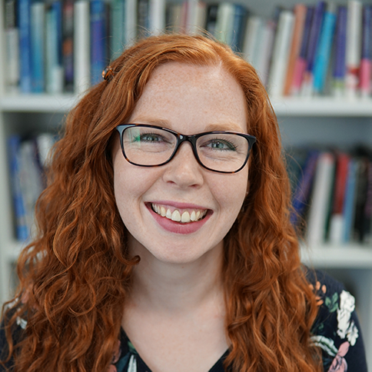

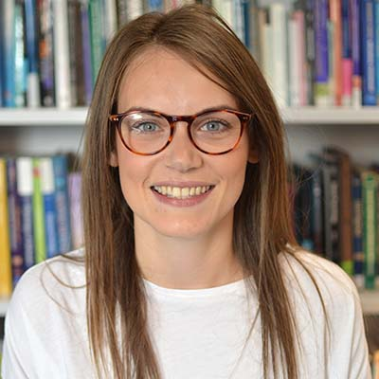

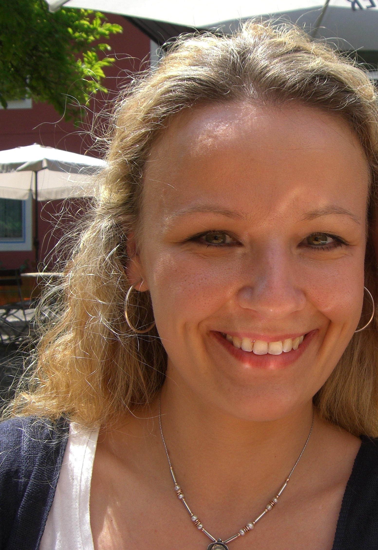
Thanks!
Student researchers:
Anna Barrowclough
Megan Bellaby
Hannah Birch
Cody Blaga
Katie Hickson
Julie Holmes
Chloe Jowett
Beth Raven
Emma Sunderland
Sam Wagland
Macy Warren
Ellen Wheeler
Rachel Wilson
Lizzie Fuller
Tessa Flack
Robin Kramer
Charlotte Cartledge
Nadine Lavan
Patricia Bestelmeyer
kritchie@lincoln.ac.uk
@KayRitchiePsych

